Slide 1
INTRODUCTION TO COMPUTERS:
Components of a PC and their functions
Memory and storage devices

Slide 2
OBJECTIVES:
Describe the four units of all computer systems
Identify system unit components
Describe the operations involved in executing a single instruction.
Tell the basic difference between system software and application software
List and explain the services provided by an operating system
Explain multitasking, multiprocessing, time‑sharing and multiprogramming
List and explain the functions of the components of an operating system

Slide 3
INTRODUCTION
A computer may be defined as a device that works under the control of stored programs, automatically accepting, storing and processing data to produce further data or information.
The computer performs the following functions:
a. Accepts Input.
b. Storage: Holds data internally before, during and after processing.
c. Processing: Performs operations on data.
d. Output: Produces data from within for external use
NB:
All computer systems regardless of their size or type have the same capabilities: Input, Processing, Output and Storage

Slide 4
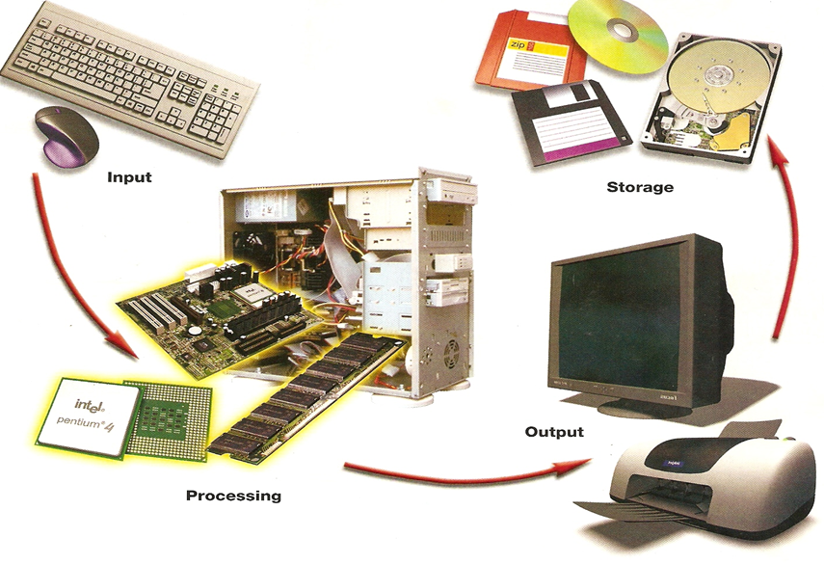
COMPUTER SYSTEM

Slide 5
Input Unit: Enables data entry in different forms (text, images, and sound) and instruction into the computer. E.g. keyboard, mouse, microphone, modem, and drawing tablet.
Processing Unit: processes that data into meaningful information. The processing unit also includes temporary storage (RAM).
Output Unit: devices used to show results of processed data to the user . E.g. monitor and printer, speakers, modem, etc.

Slide 6
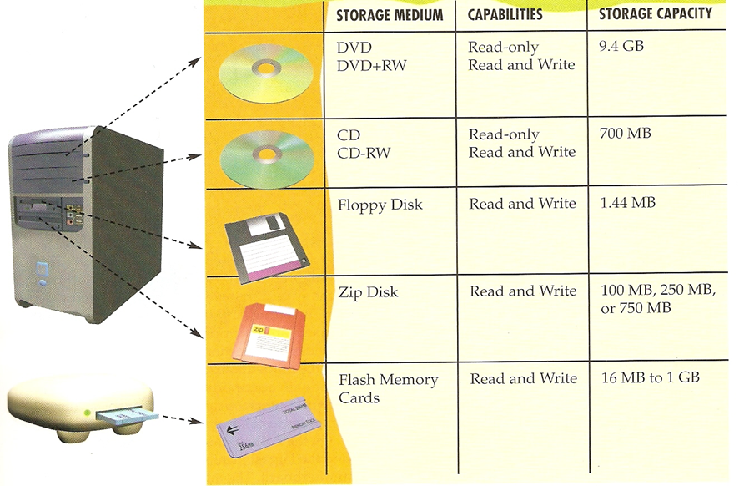
Storage devices: Storing of processed data

Slide 7
HARDWARE:
The physical components of a computer system ‑ the system unit and all its contents, the keyboard, mouse, monitor, etc are all computer hardware.
PC hardware consists of:
The System Unit and
Attached devices called peripherals, e.g. monitor, keyboard, and mouse and maybe; speakers, a modem, printer, scanner, etc.

Slide 8
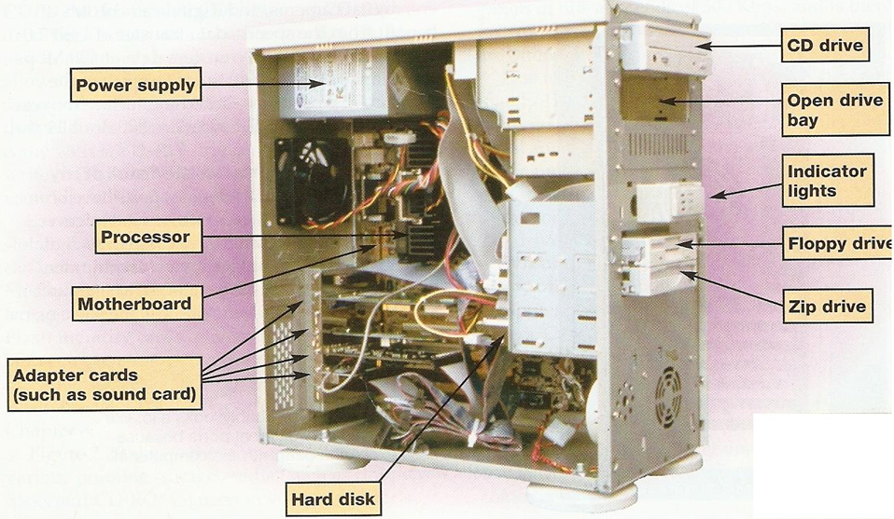
SYSTEM UNIT COMPONENTS

Slide 9
THE MOTHERBOARD
The motherboard provides the following basic functionalities:
It provides connectivity for all system components.
It distributes power to every component on the motherboard.
Provides various connectors for attaching components such as the Network Interface Card (NIC), Video Card, Modem, Sound Card, Keyboard, Mouse, etc.
.

Slide 10
The following components are found on a typical motherboard:
Expansion slots
Processor socket
Memory slots
On ‑board drive connectors
Power connector
Keyboard and mouse connectors
Peripheral port and connectors
CMOS battery

Slide 11
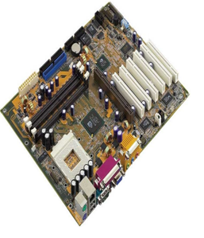
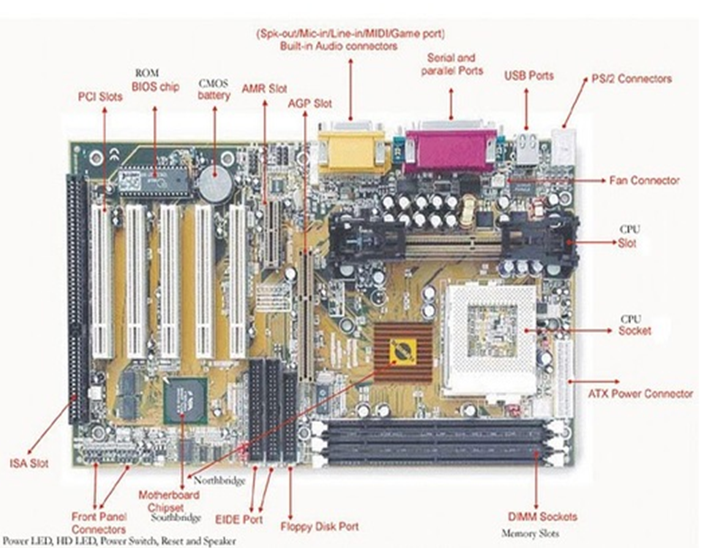
A TYPICAL MOTHERBOARD

Slide 12
CENTRAL PROCESSING UNIT (CPU)
The CPU is the `brain' of the computer. The processor works hand in hand with other circuits known as main memory and registers to carry‑out processing.
The CPU (Central Processing Unit) takes the data entered into the PC and processes that data into meaningful information;
Examples include running a specific program, producing a sound, drawing an image on‑screen, etc.
The processing unit also includes temporary storage (RAM) in which the information currently being processed is stored temporarily.

Slide 13
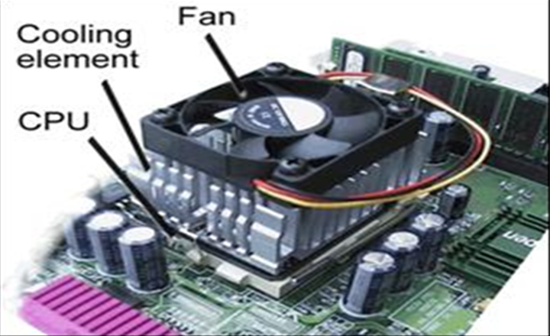
Central Processing Unit

Slide 14
The processor consists of two units:
Control Unit and Arithmetic/Logic Unit.
The Control Unit:
Tells the rest of the computer system how to carry out a program's instructions.
It directs the movement of electronic signals between main memory and the arithmetic/logic unit.
It also directs these electronic signals between main memory and the input and output devices.

Slide 15
The arithmetic logic unit (ALU):
Performs arithmetic and logic operations
Does comparisons
Controls the speed of the various operations.
To execute a single program instruction, the processor performs a series of operations referred to as the machine cycle.

Slide 16
THE CPU MACHINE CYCLE
FETCH: When any program begins to run, the program's binary code is "fetched" from the random access memory (RAM) and to the CPU.
DECODE: Once the program's binary code is in the CPU, it is "decoded" into the commands the CPU understands.
EXECUTE: Next, the CPU actually performs the work described in the command. Specialized hardware on the CPU performs the mathematical and logical operations at incredible speeds.
STORE: The result is stored in registers, special memory storage areas built into the CPU. The CPU is then ready to fetch the next set of bits encoding the next instruction.

Slide 17
RANDOM ACCESS MEMORY (RAM)
RAM is the temporal working storage of the computer.
RAM is volatile – it only works while the power is on.
RAM has three tasks:
It holds data for processing.
It holds instructions (programs) for processing data.
It holds data that has been processed

Slide 18
READ ONLY MEMORY (ROM) CHIPS
ROM is an acronym for Read Only Memory.
ROM is non‑volatile.
One of the ROM chips in a PC contains instructions the computer needs when it is turned on or booted. These instructions are called ROM bootstrap.
A ROM chip helps the processor transfer information between the keyboard, screen, printer, and other peripheral devices to make sure all units are functioning properly. These instructions are called ROM BIOS (basic input/output system).

Slide 19
Expansion Card and Slots
Extra functionality can be added to a computer by connecting an expansion card. Some examples are:
Graphics card
Sound card
Network Interface Card (NIC)
Internal modem

Slide 20
PORTS
A port is a socket on the outside of the system unit that is connected by a bus to the motherboard on the inside of the system unit or connected directly to integrated circuitry on the motherboard.
A port allows connection to peripheral devices, such as monitor, mouse, keyboard, printer, so that it can communicate with the computer system.

Slide 21
PORTS
Parallel port: It is a 25‑pin female connector that principally allows connection to printers.
Serial ports: Serial port also known as RS‑32 port is a 9‑pin or 25‑pin male connector that principally allows connection to modems and scanners.
Video adapter port: It is a 15‑pin Female connector used to connect to the video display monitor .
USB ports: USB (Universal Serial Bus) allows connection to up to 127 devices using only one port.

Slide 22
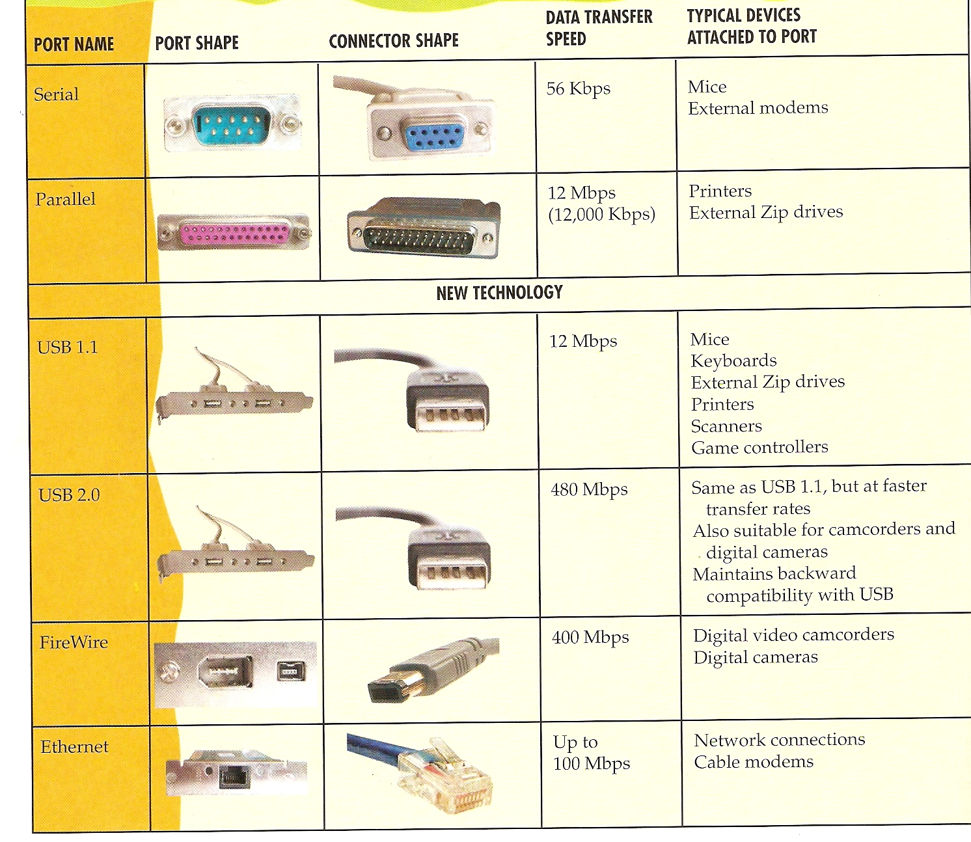

Slide 23
SOFTWARE
Is the general term used to describe all the various programs that may be used on a computer system together their associated documentation.
There are two basic types of software:
System software tells the computer how to communicate with peripheral devices.
Applications software programs are programs designed to satisfy a user's needs.

Slide 24
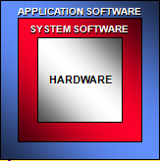
Operating System
Schedules and monitors
computer events
Allocate computer resources
Language translators
Interpreters
Compilers
Utilities
Routine operations
Manage data
Programming languages:
Cobol, Qbasic, Pascal, C/C++

Slide 25
SYSTEM SOFTWARE:
Starts up the computer and functions as the principal coordinator of all hardware components.
Without System software loaded into the computer's RAM, hardware and applications software are useless.
System software comprises a large number of instructions that can be grouped into three basic parts:
1. Operating system.
2. Utilities
3. Language translators.

Slide 26
OPERATING SYSTEM
Operating system (OS): set of programs that controls the computer hardware and acts as an interface with application programs.
Kernel: ties all components of the OS together and regulates other programs.
OS converts basic request into a set of details instruction that the hardware requires.
Common hardware functions (e.g.)
Get input from keyboard or some other input device
Retrieve data from disks
Store data on disks
Display information on a monitor or printer

Slide 27
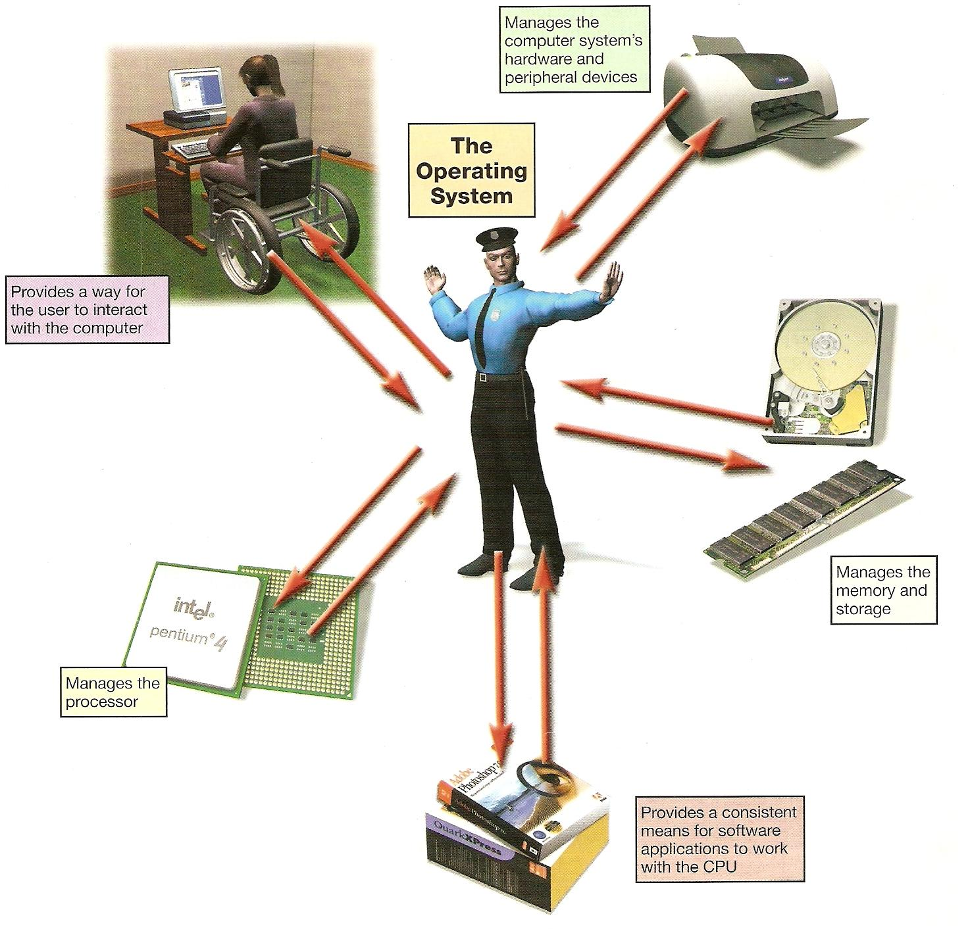
THE OPERATING SYSTEM

Slide 28
FUNCTIONS OF THE OS
It provides a way for the user to interact with the computer.
It manages the central processing unit (CPU).
It manages the memory and storage.
It manages the computer system's hardware and peripheral devices.
It provides a consistent means for software applications to work with the CPU.

Slide 29
THE BOOT PROCESS
1. The basic input/output system (BIOS) is activated by powering on the CPU.
2. The BIOS checks that all attached devices are in place (called a Power‑ On Self ‑ Test, or POST)
3. The operating system is loaded into RAM.
4. Configuration and customization settings are checked.

Slide 30
Some Well – Known Pc Operating Systems:
Windows 98, Windows XP, Windows Vista, Windows 7, Windows NT by Microsoft.
MacOS for Apple Macintosh Computers.
Linux, which is a PC version of the Unix Operating Systems. ( e.g. RedHat, Suse, Ubuntu, Debian, etc)
Solaris by Sun Microsystems.

Slide 31
Components of an Operating System
Process Manager and Scheduler
Memory Manager
File Manager
I/O Management
Secondary Storage Management
Network Manager
Protection System
Command interpreter system

Slide 32
Process Manager and Scheduler
The five major activities of an operating system in regard to process management are:
Creation and deletion of user and system processes.
Suspension and resumption of processes.
A mechanism for process synchronization.
A mechanism for process communication.
A mechanism for deadlock (standstill) handling.

Slide 33
As a process manager, the OS allows;
Multitasking: more than one program can run at the same time
Time-sharing: allows more than one person to use a computer system at the same time
Many users share the large CPU
Time in the CPU is divided into slices (e.g. 2 microseconds)
Each user has access to CPU during a slice
A user’s job is swapped out at the end of slice
Scalability: ability of the computer to handle an increasing number of coexisting users smoothly
Multiprocessing:
Two or more processors in system
Programs can be divided to be processed by multiple CPUs
And this allows the CPU processes large data more rapidly

Slide 34
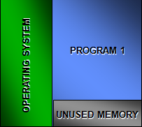
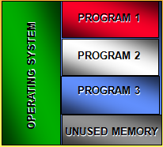
Multiprogramming:
Traditional single
program system
Multiprogramming
environment

Slide 35
MEMORY MANAGER
The major activities of an operating in regard to memory ‑ management are:
Keep track of which part of memory are currently being used and by whom.
Decide which processes are loaded into memory when memory space becomes available.
Allocate and de ‑ allocate memory space as needed

Slide 36
FILE MANAGER
The five main major activities of an operating system in regard to file management are:
The creation and deletion of files.
The creation and deletion of directories.
The support of primitives for manipulating files and directories.
The mapping of files onto secondary storage.
The back up of files on stable storage media.

Slide 37
User interface and input/output management
I/O subsystem hides the distinctive features of specific hardware devices from the user.
Only the device driver knows the peculiarities of the specific device to which it is assigned. These device drivers tell the respective devices how to work.
User interface: allows individuals to access and command the computer system

Slide 38
THE USER INTERFACE
The user interface enables you to interact with the computer.
3 Types of user interface
Command ‑ driven interface requires that text commands be given to the computer to perform basic activities. E. g. DOS (Disk operating system).
Menu driven interface is one in which you choose a command from menus displayed on the screen. E.g. Mac OS
Graphical user interface (GUI) : uses icons and menus displayed on screen to send commands to the computer system, making them much more user friendly. E.g. Windows, Vista.

Slide 39
SECONDARY STORAGE
The three major activities of an operating system in regard to secondary storage management are:
Managing the free space available on the secondary storage device.
Allocation of storage space when new files have to be written.
Scheduling the requests for memory access.

Slide 40
NETWORK MANAGER
This component manages access to resources (files, printers, etc) over a distributed system.
The network manager deals with problems of contention and security over the communication network.

Slide 41
PROTECTION SYSTEM
Protection refers to mechanism for controlling the access of programs, processes, or users to the resources defined by a computer system.
The resources (files, memory, CPU time) of one user and process must be protected from others.
This is done to ensure that a component that is not working properly won't damage the rest of the system.
Also people who don't know what they are doing can't do too much damage either.

Slide 42
Command Interpreter System
A command interpreter is an interface of the operating system with the user.
Command line interface (e.g : DOS, shell)
Graphical User Interface (GUI)
It is usually not part of the kernel, since multiple command interpreters may be supported by an operating system.
The kernel is the core that provides basic services for all other parts of the operating system.

Slide 43
Utility programs
Help to perform maintenance or correct problems with a computer system
Common types of utility programs:
Hardware utilities
Virus-detection and recovery utilities
File-compression utilities
Spam and pop-up blocker utilities

Slide 44
Language translation
Source code: High level language instructions
Compiler: translates high level codes to machine language
Object code: Translated instructions that are ready for the computer to use.

Slide 45
Language translation
Compiler
Interpreter
Assembler
IF A := B
THEN
1001101
1110101
0010110
Language
Translator
Program
Source
Program
Written in
QBASIC,
COBOL,
etc.
Language
Translation
Process
Machine
Language
Object
Program

Slide 46
Language translators
Machine Languages
Use binary coded
instructions
High Level Languages
Use brief statements
Markup Languages
Use embedded
control codes
1001 1001
1100 1101
Compute X = Y + Z
<H1>First heading</H>
<!ELEMENT Product
(#Item | manuf)>
Assembler Languages
Use symbolic coded
instructions
Fourth Generation
Languages
Use natural statements
Object-Oriented
Languages
Define objects that
contain data and actions
LOD Y
ADD Z
SUM THE FOLLOWING NUMBERS
Document.write
(“Hi There”)

Slide 47
Application Software
Primary function is to apply the power of the computer to give individuals, workgroups, and the entire enterprise the ability to solve problems and perform specific tasks.
Application programs interact with systems software; systems software then directs computer hardware to perform the necessary tasks.

Slide 48
Overview of Application Software
Proprietary software: one-of-a-kind program for a specific application, usually developed and owned by a single company.
Off-the-shelf software: existing software program that is purchased

Slide 49
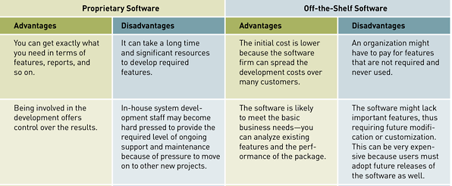
Overview of Application Software (continued)
Table 4.4: A Comparison of Proprietary and Off-the-Shelf Software

Slide 50
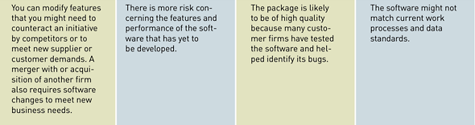
Overview of Application Software (continued)
Table 4.4: A Comparison of Proprietary and Off-the-Shelf Software (continued)

Slide 51
Programming Languages
Sets of keywords, symbols, and a system of rules for constructing statements by which humans can communicate instructions to be executed by a computer.
Different languages have different characteristics
Syntax: a set of rules associated with a programming language

Slide 52
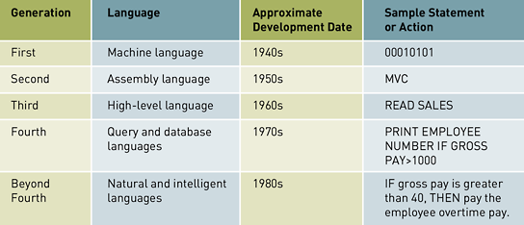
The Evolution of Programming Languages
Table 4.9: The Evolution of Programming Languages

Slide 53
The Evolution of Programming Languages (continued)
Visual, object-oriented, and artificial intelligence languages are easier for nonprogrammers to use than older generation languages
Visual languages use a graphical or visual interface for program development
Object-oriented programming languages are based on objects
Compiler: a special software program that converts programmer’s source code into machine-language instructions consisting of binary digits

Slide 54
Software Issues and Trends
Because software is such an important part of today’s computer systems, software issues have received increased attention
Major software issues and trends discussed in the text
Software bugs, copyright, software licensing, open-source software, shareware and public domain software, multi-organizational software development, software upgrades, and global software support

Slide 55
Software Bugs
Software bug: defect in a computer program that keeps it from performing as it is designed to perform
Tips for reducing impact of software bugs
Register all software so that you can receive bug alerts, fixes, and patches
Check the manual or read-me files for work-arounds
Access support area of the manufacturer’s Web site for patches
Install the latest software updates

Slide 56
Copyrights and Licenses
Most software products are protected by law using copyright or licensing provisions
In some cases, you are given unlimited use of software on one or two computers
In other cases, you pay for your usage—if you use the software more, you pay more
Some software now requires that you register or activate it before it can be fully used

Slide 57
Open-Source Software
Open-source software: software freely available to anyone in a form that can be easily modified
Some widely used open-source software packages: Linux OS, Apache, Sendmail, Perl
Open-source software is often more reliable and secure than commercial software
Open-source systems can contain hidden costs, particularly for user support or solving problems with the software

Slide 58
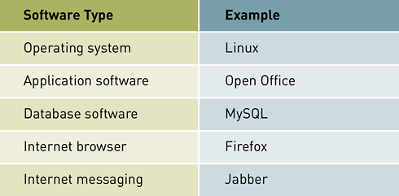
Open-Source Software (continued)
Table 4.10: Examples of Open-Source Software

Slide 59
Shareware, Freeware, and Public Domain Software
Shareware and freeware: software that is very inexpensive or free, but whose source code cannot be modified
Public domain software: shareware and freeware that is in the public domain

Slide 60
Software Upgrades
Software companies revise their programs and sell new versions periodically
Revised software may or may not offer any major additional capabilities
Revised software can contain bugs or errors
Software upgrades usually cost much less than the original purchase price

Slide 61
Global Software Support
Vendors face the challenge of providing adequate support for their software customers in all locations of the world
Trend of outsourcing global support to one or more third-party distributors

Slide 62
Summary
Computer programs: sequences of instructions for the computer
Systems software: coordinates the activities of hardware and programs
Applications software: helps users solve particular problems
Operating system (OS): set of computer programs that controls the computer hardware and acts as an interface with application programs

Slide 63
Summary (continued)
Graphical user interface (GUI): user interface that uses icons and menus displayed on screen to send commands to the computer system
Time-sharing: allows more than one person to use a computer system at the same time
Proprietary software: one-of-a-kind program for a specific application, usually developed and owned by a single company
Off-the-shelf software: existing software program that is purchased

Slide 64
Summary (continued)
Enterprise resource planning (ERP) software: manages a company’s vital business operations for an entire multisite, global organization
Programming languages: allow humans to communicate instructions to be executed by a computer
Most software products are protected by law using copyright or licensing provisions
Open-source software is freely available to anyone in a form that can be easily modified

Slide 65
????
?

